Slide 1
Learning From A Distance:
How Pathology Education
Has Changed Since 2019
Raul S. Gonzalez, MD
Emory University Hospital

Slide 2
Disclosure of Relevant Financial Relationships
I have done consulting work for
  Astellas Pharma Inc
  Bristol Myers Squibb
  GlaxoSmithKline
  Vertex Pharmaceuticals
No information related to these activities will be discussed in this talk
*I have done work for PathologyOutlines, I co-founded VPGR, I have given pathCast lectures, I am on the board of OPEN, and I currently help produce the PIP series for CAP
RDC Nº 96/08 da ANVISA

Slide 3

Traditional Methods of Pathology Education
Textbooks
Formal lectures
At-the-scope teaching
Resident-resident interactions
Attending conferences and courses
Slide mailings (eg, CAP PIPs*)

Slide 4
Early Online Methods of Pathology Education
PathologyOutlines*
Institution-specific web sites (eg, WebPath)
Question banks (eg, Johns Hopkins)
Image banks (eg, WebPathology)
Resident-shared knowledge
Audio lectures (eg, Goljan)
Google

Slide 5
Modern Methods of Pathology Education
Social media (eg, Twitter/X)
Videos (eg, YouTube, pathCast*)
Digital slides (eg, PathPresenter)
PathElective
Pathoma

Slide 6
--- 2019/2020 ---
Pandemic heightened the need for online education and accelerated its development
Newer online lecture series (CAP, VPGR*)
Transition from in-person to virtual lectures and conferences
Increase in social media activity
Zoom and/or scanned slides for signout
Open Pathology Education Network*

Slide 7
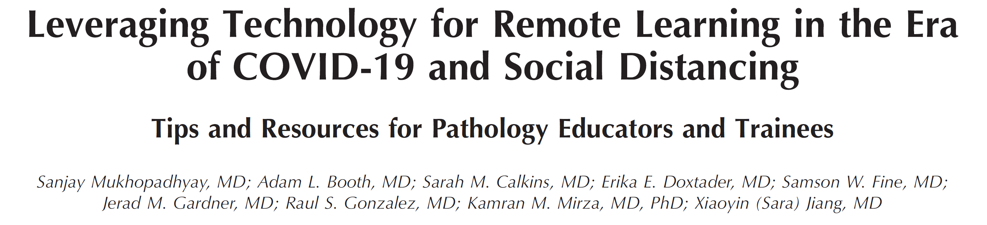
Overview of (Post-)Pandemic Education

Slide 8
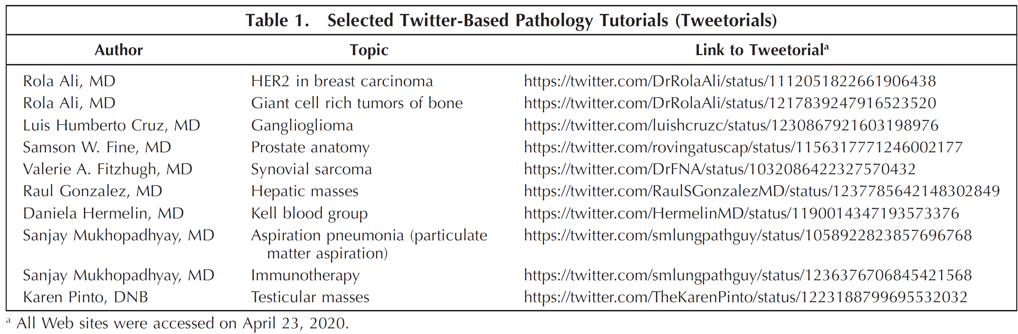

Slide 9
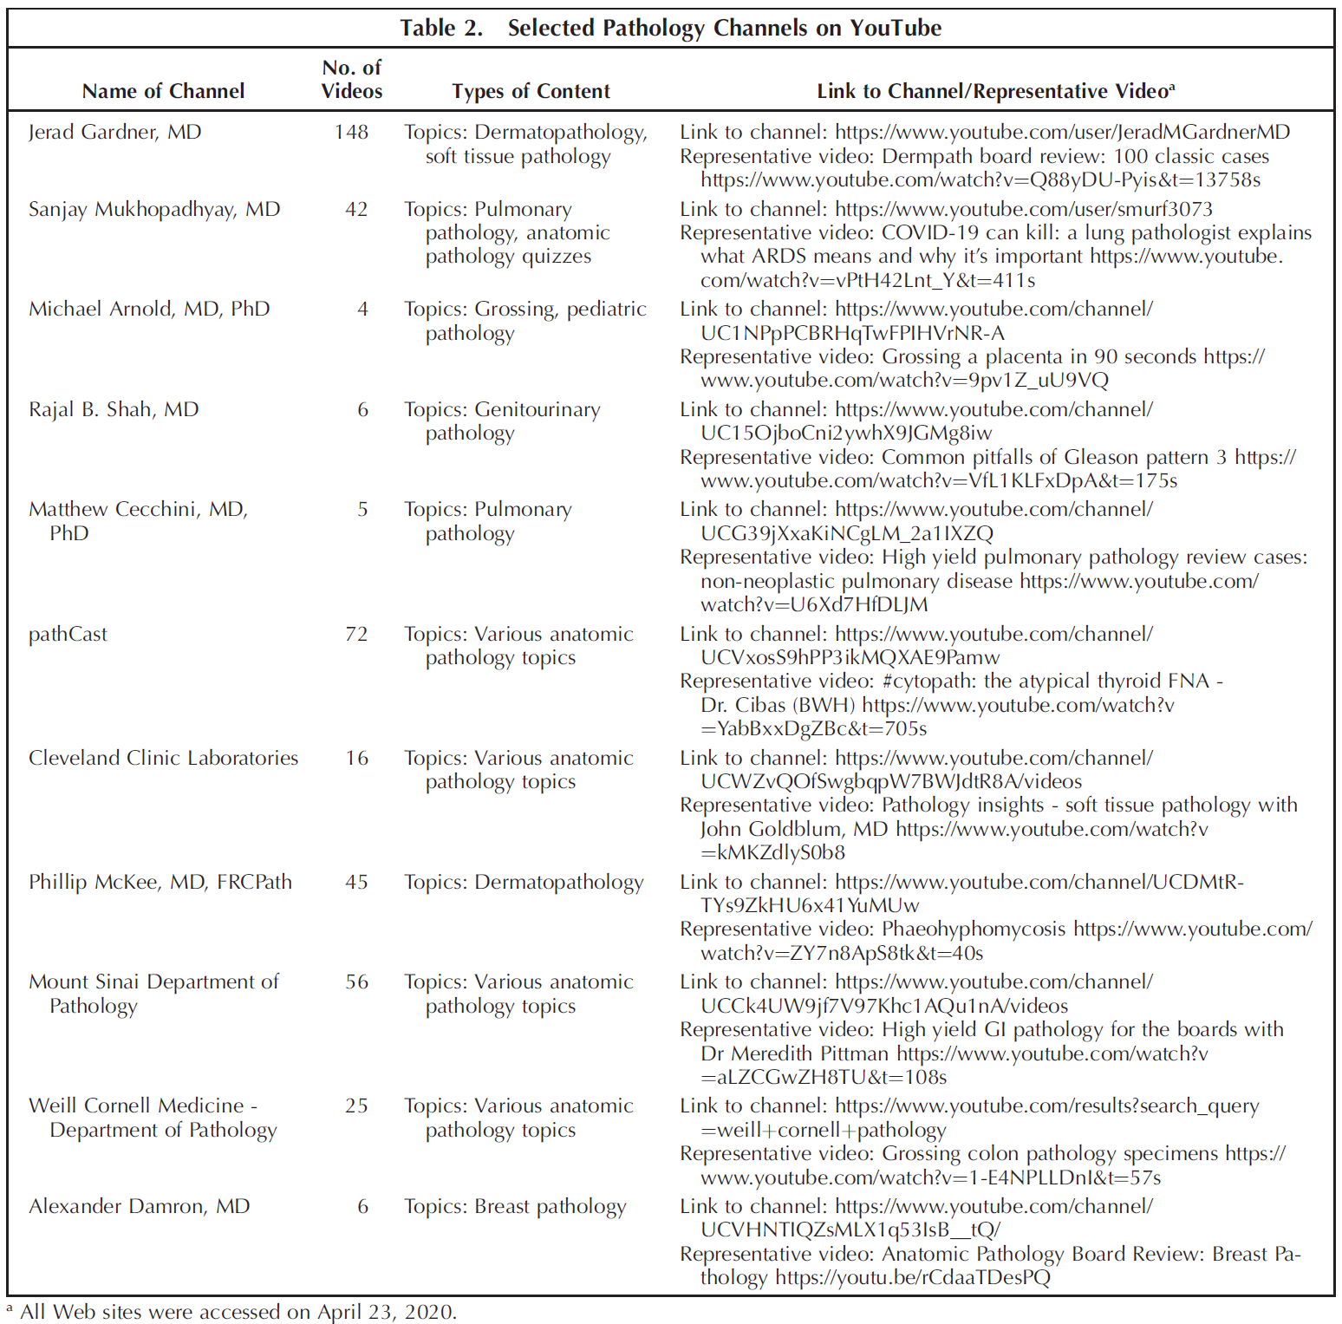

Slide 10
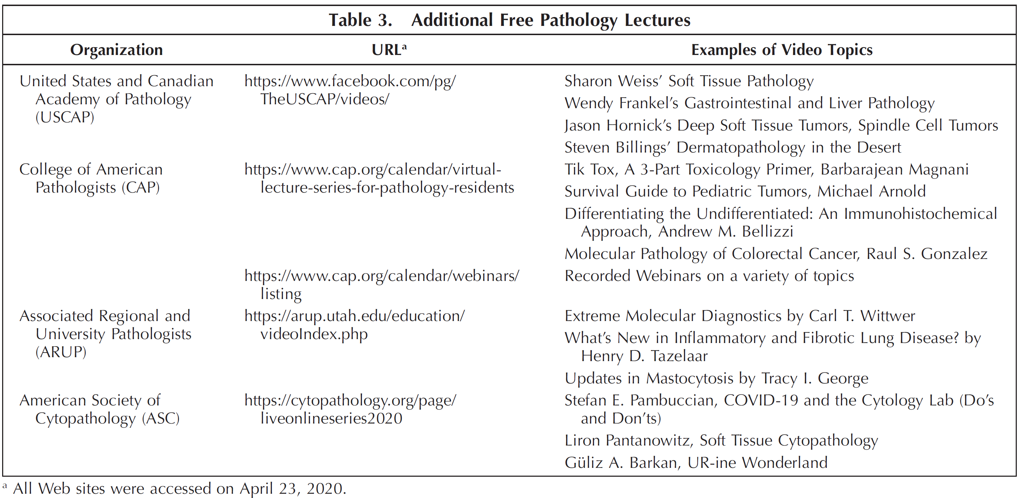

Slide 11
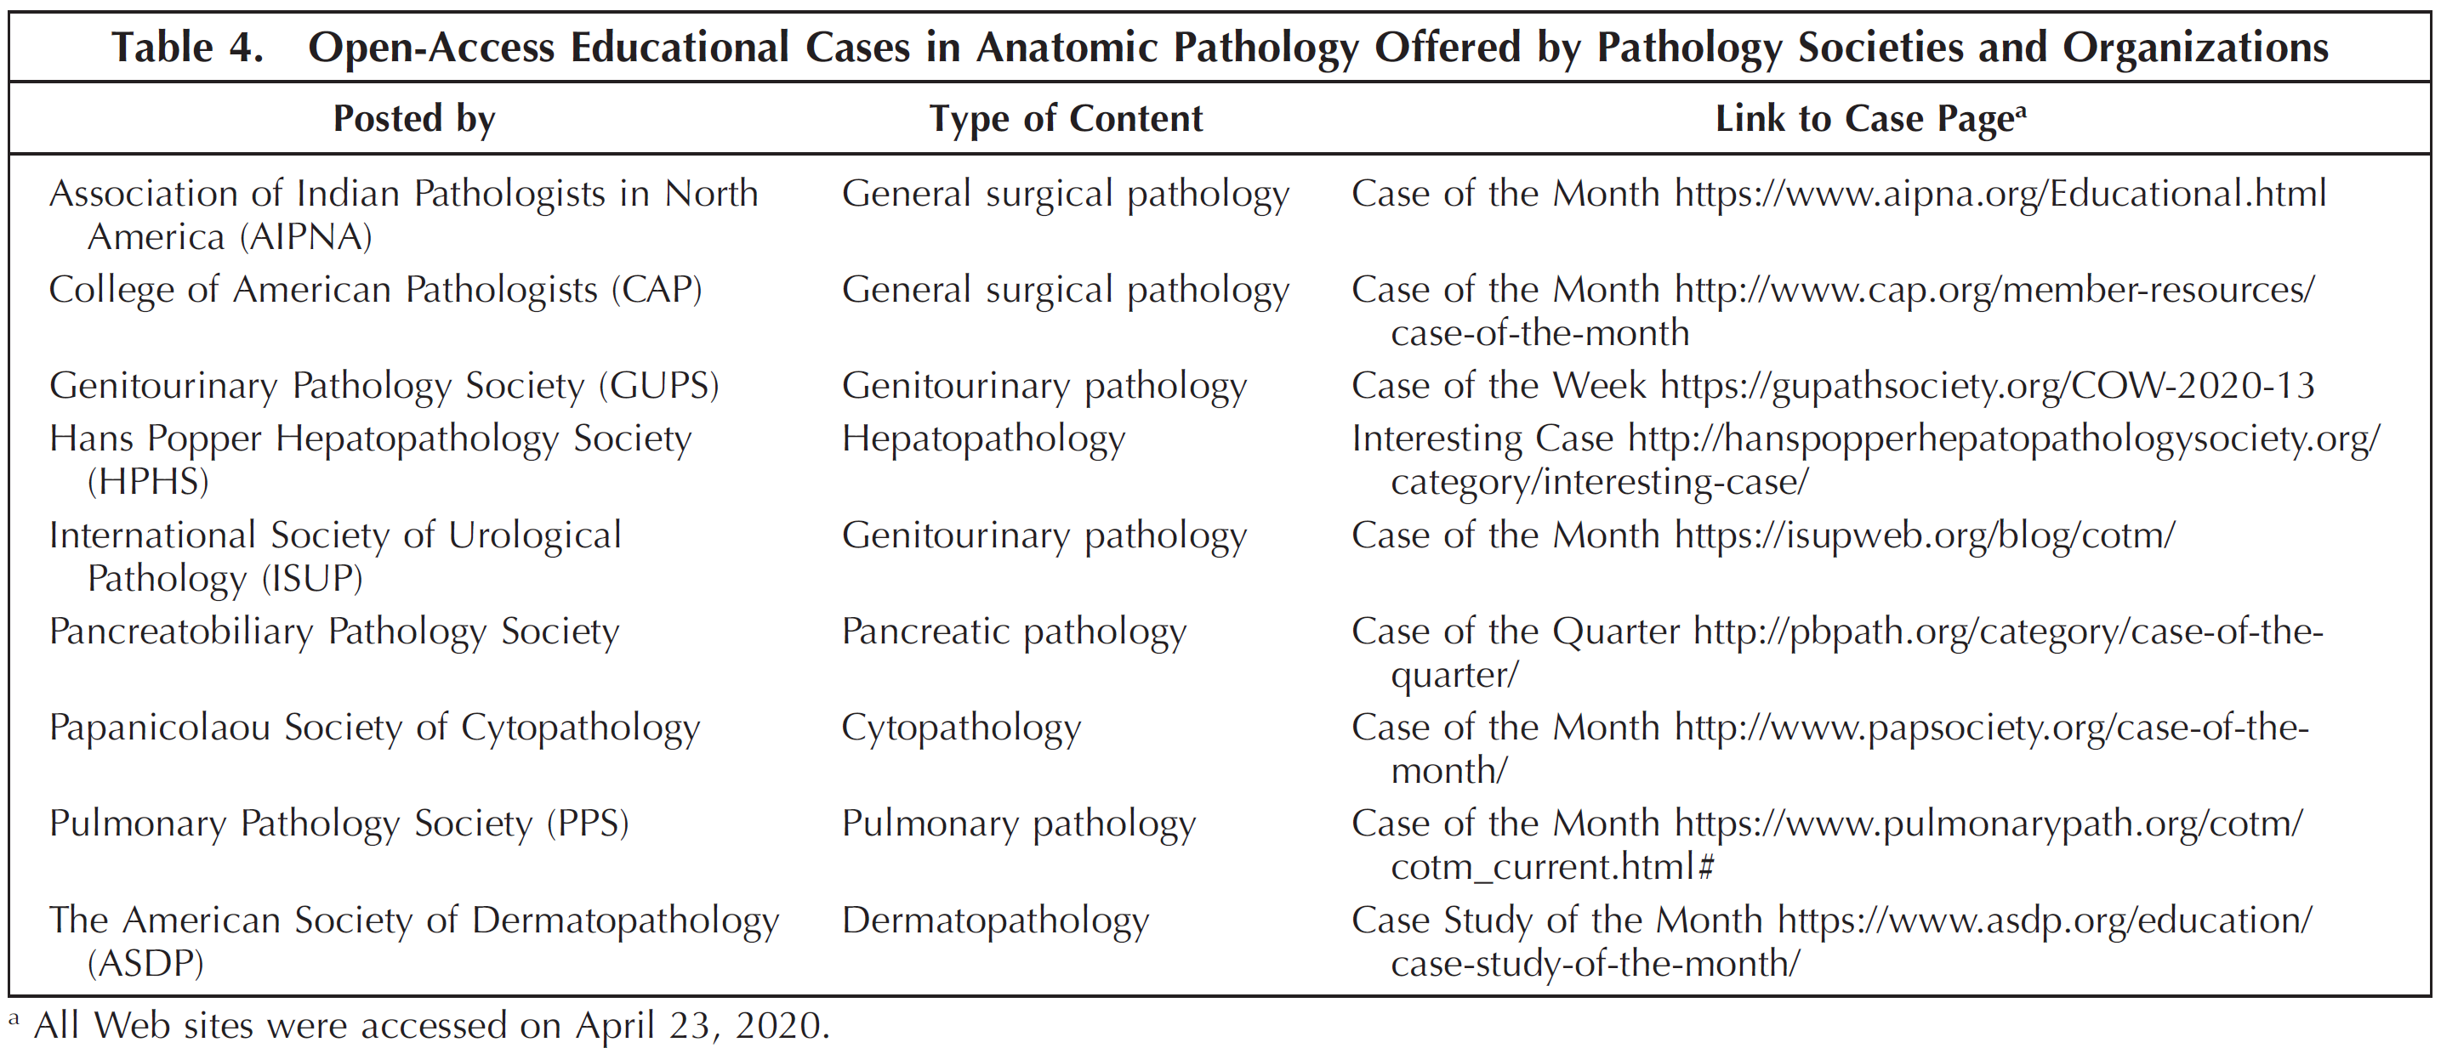

Slide 12
Benefits of Traditional Pathology Education
Tried, tested, and true (quality of information)
Organic flow of in-person interaction
Traditional lecture format does work for some

Slide 13
Benefits of Modern Pathology Education
High volume of educational material (quantity of information)
Most material is free to access
Variety of learning approaches accommodated
Different perspectives can lead to robust, well-rounded education

Slide 14
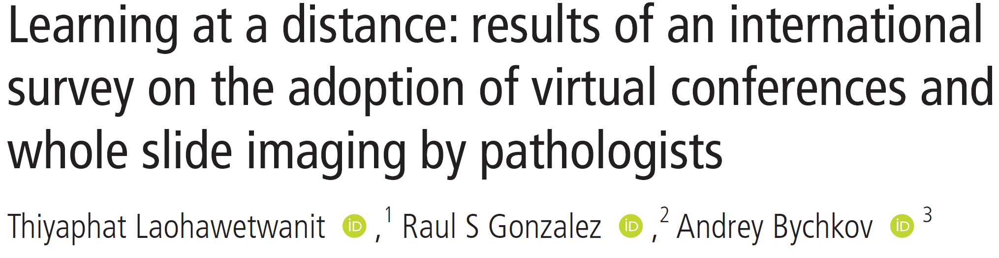
How Do Pathologists Feel About This?

Slide 15
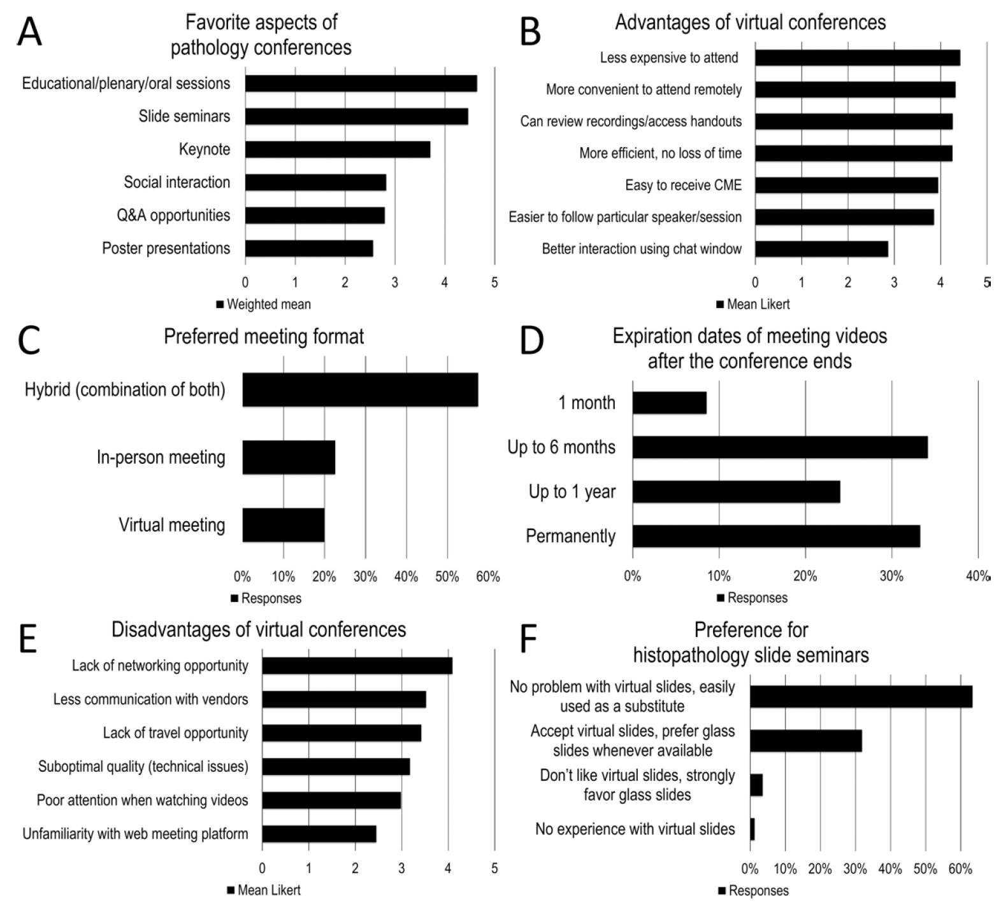

Slide 16
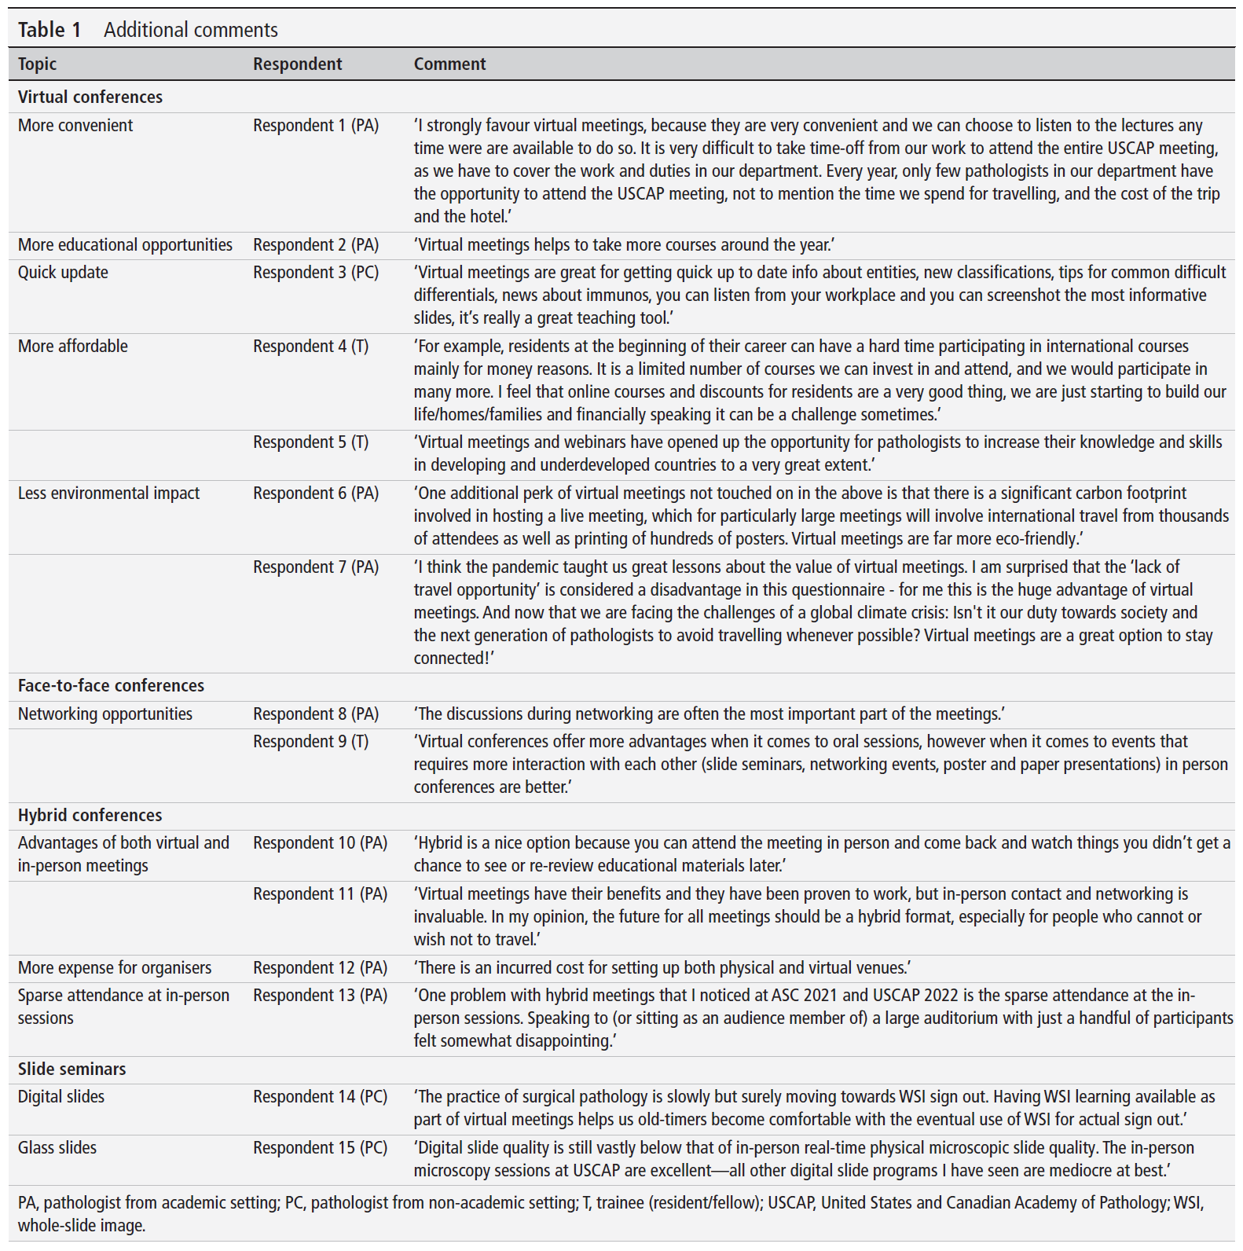

Slide 17
Whole Slide Images
Becoming more common
Several laboratories using for primary diagnosis and/or archival storage
Can be used for educational presentations and for educational resources
Quality has improved
Concerns: expensive to implement and maintain digital solution; file storage; no 3rd dimension to slides
Some pathologists will always prefer glass slides!

Slide 18
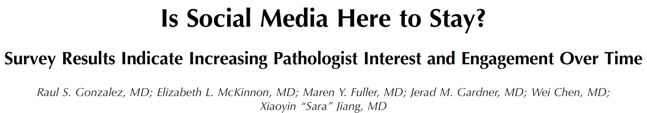
Pathologists and Social Media in 2022

Slide 19
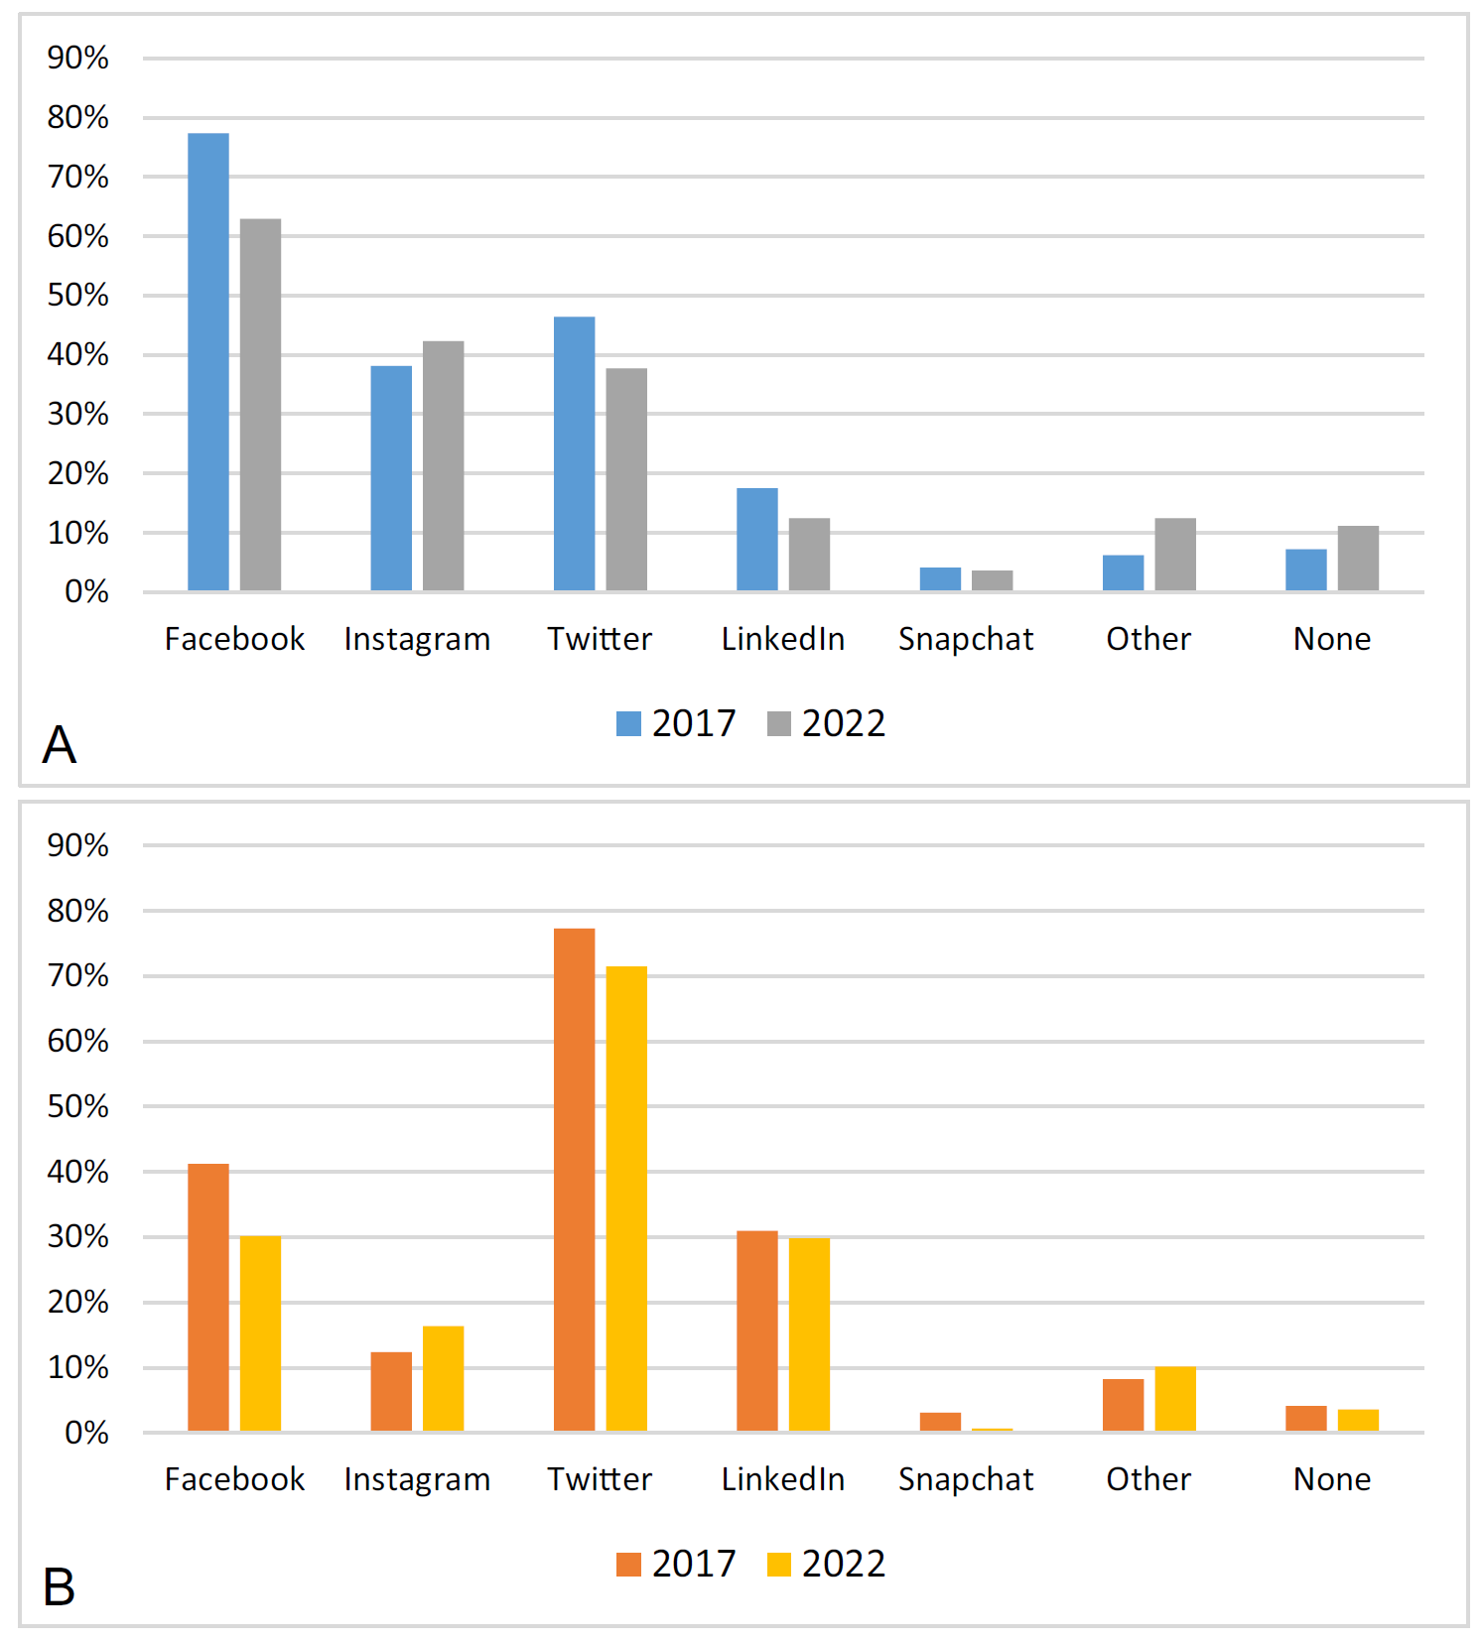

Slide 20
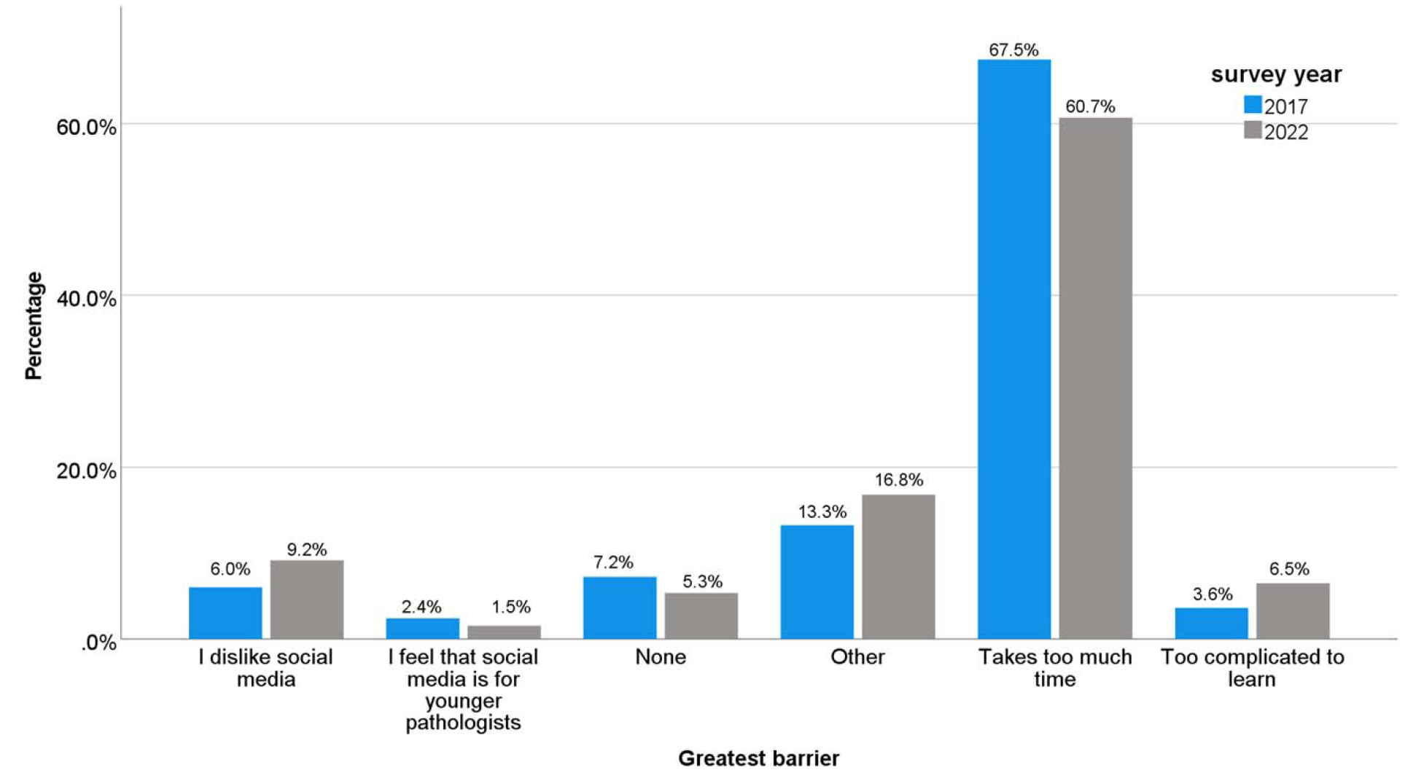

Slide 21
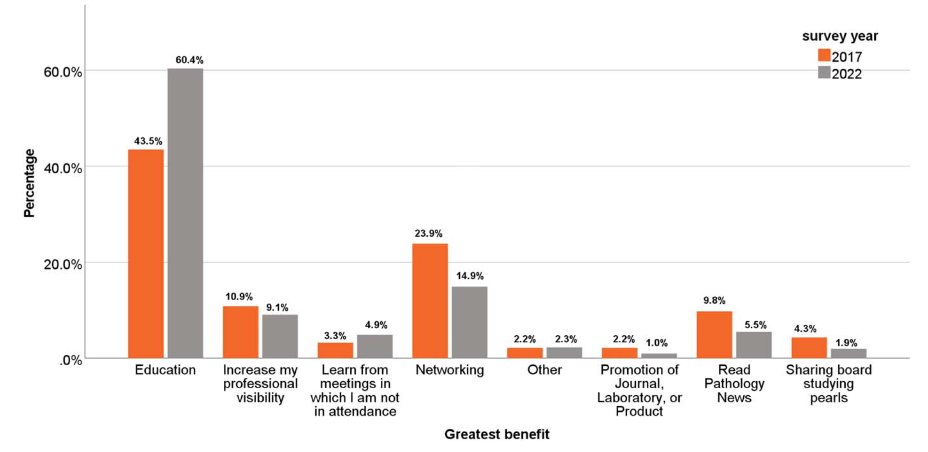

Slide 22
What About Artificial Intelligence?
AI is potentially a powerful tool for pathology education
Currently not much more advanced than typing questions into ChatGPT
Could not only diagnose virtual slides, but annotate them
Useless unless tightly monitored and vetted (garbage in, garbage out)

Slide 23
My Own Opinions
This wealth of educational material is great, but always consider the source
Social media is a great resource, but it’s crucial to separate the signal from the noise
The full value of conferences comes from in-person attendance, but it’s great that hybrid options are available
Do not overlook the value of traditional resources (textbooks, etc.)
Keep pushing (virtual?) glass – there is no substitute for experience

Slide 24
References
Gonzalez RS, et al. Is Social Media Here to Stay?: Survey Results Indicate Increasing Pathologist Interest and Engagement Over Time. Arch Pathol Lab Med. 2024 Feb 14 (Online ahead of print).
Laohawetwanit T, et al. Learning at a distance: results of an international survey on the adoption of virtual conferences and whole slide imaging by pathologists. J Clin Pathol. 2023 May 19 (Online ahead of print).
Mukhopadhyay S, et al. Leveraging Technology for Remote Learning in the Era of COVID-19 and Social Distancing. Arch Pathol Lab Med. 2020;144:1027-1036.

Slide 25

Questions?

Slide 26
Thank You!

